Slide 1

Product recognition using computer vision and sensor

Slide 2

Content
Team
Problem & Objective
EDA
Data Understanding
Data Quality Report
Appendix
Data Visualization

Slide 3
Team
Noufal Babu, MBA in IT & System, Principle Embedded Software Engineer
Ali Boukhari, Master degree in engineering, Data analyst

Slide 4

Problem
Our business is currently experiencing delays in the manual product checkout process at the store :-
With the advent of modern shopping experiences, manual checkouts have become a point of friction for customers, causing delays and inefficiencies in our business operations. The traditional checkout process may not only hinder our business growth but also impact customer satisfaction levels.

Slide 5
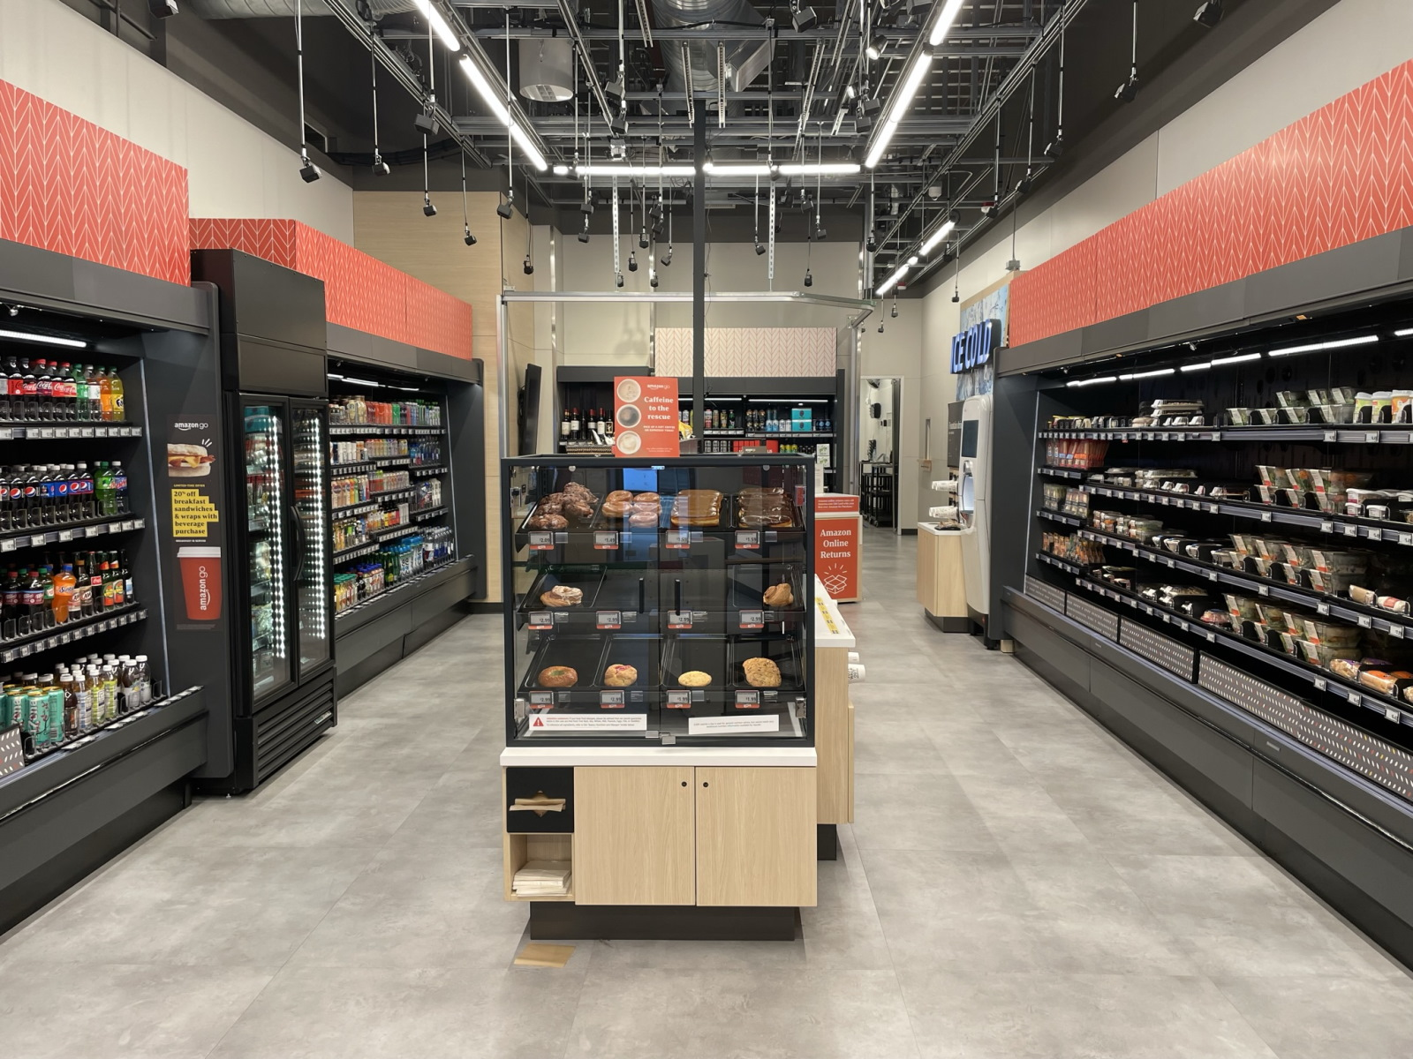
Objective
Our business want to provide shop and go experience to our customers, with customers able to purchase products without being checked out by a cashier or using a self-checkout station

Slide 6
EDA - Data description of data
Sl # | Image | Num Contours | Num Edges | Mean Red | Mean Green | Mean Blue
0 | 0.jpg | 1 | 1379040 | 119.87 | 118.12 | 129.39
1 | 1.jpg | 1 | 1453755 | 120.31 | 118.46 | 129.44
2 | 10.jpg | 1 | 1320645 | 119.34 | 117.54 | 128.58
3 | 100.jpg | 1 | 1001130 | 107.67 | 108.69 | 119.96
4 | 101.jpg | 1 | 992715 | 107.87 | 109.13 | 119.79
Sample Product data
 | Num_Contours | Num Edges | Mean Red | Mean Green
count | 244 | 244.00 | 244.00 | 244.00
mean | 1 | 1264135.00 | 118.17 | 117.06
std | 0 | 159947.20 | 3.52 | 2.77
min | 1 | 951660.00 | 107.67 | 108.69
25% | 1 | 1137491.00 | 116.29 | 114.99
50% | 1 | 1269900.00 | 118.71 | 117.39
75% | 1 | 1392236.00 | 120.76 | 118.70
Observations:
We have 10 different products by CV, supported by many 224x224 images of each product
The number of edges in images varies, with a mean of approximately 1,264,135.
The mean values for red, green, and blue are approximately 118.17, 117.06, and 128.69, respectively.

Slide 7
Data Understanding
Data type
Data source
Data summary
Primary variables for model buildup
Unstructured -
Images
Structured and contained in a .csv file - Weight
Internal database
1169 images
All images have exactly 1 contour
Edges in images 1,264,135
Label, colors, weight

Slide 8
Descriptive statistics from the project data
Product Interaction Distribution: How are different products interacted with by customers throughout the store? (e.g., Which products are most commonly picked up, added to carts, or returned?)
Time Analysis: At what times of day or days of the week are interactions (like picking up or returning products) most prevalent in the store?
Customer Behavior Patterns: Are there distinct patterns or sequences in which customers typically interact with products? (e.g., Do they first pick up one category of product before another?)
Water
Evening
No pattern

Slide 9
Data quality report
Image Data
Weight Data
Completeness: No missing values in Num Contours and Num Edges. Text column is entirely missing.
Consistency: Values in numerical columns ar consistent.
Distribution:
Num Contours: Symmetrical (Skewness = 0).
Num Edges: Slightly skewed (Skewness = -0.041).
Outliers: None observed for numerical columns.
Duplicates: None found
Completeness: No missing values.
Consistency: Right-skewed Product weight distribution (Skewness = 0.838).
Outliers: Potential outliers in Product weight need investigation.
Categorical Data: Variations in Description frequencies; consider consolidating categories.
Duplicates: None found.
Recommendations:
Investigate and handle outliers and skewness in Product weight Dataset .

Slide 10
Appendix

Slide 11
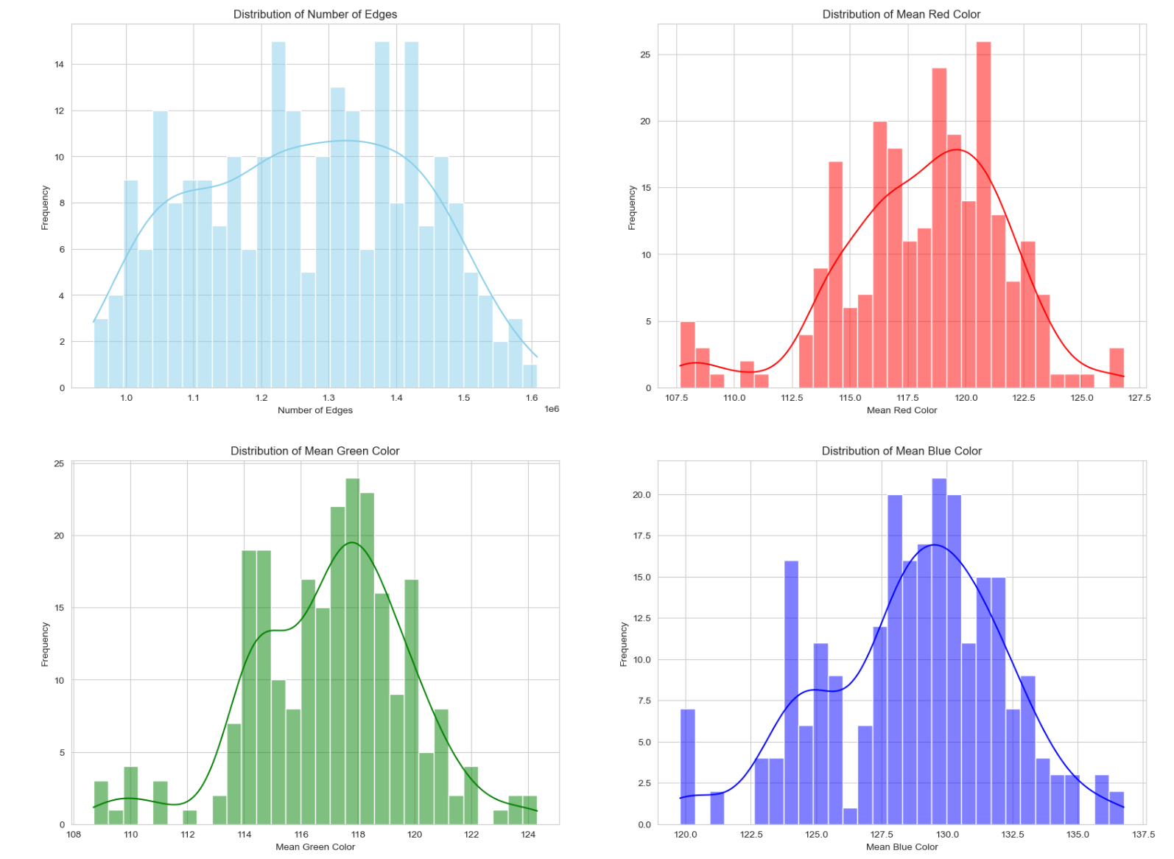
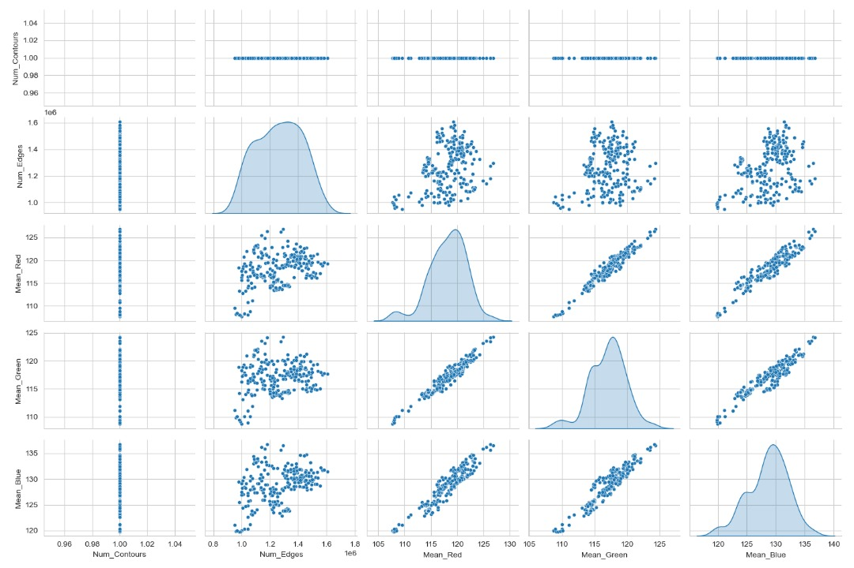
Image Distribution

Slide 12
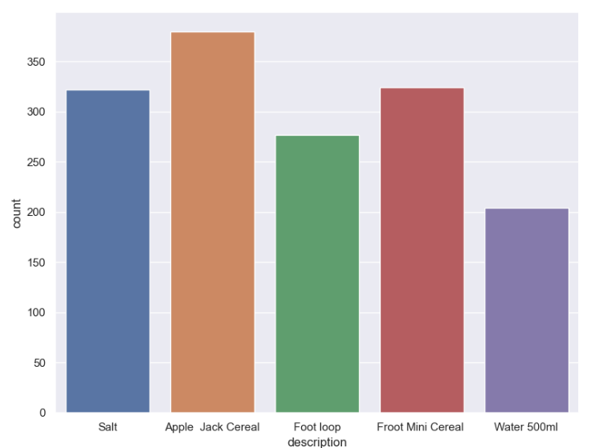
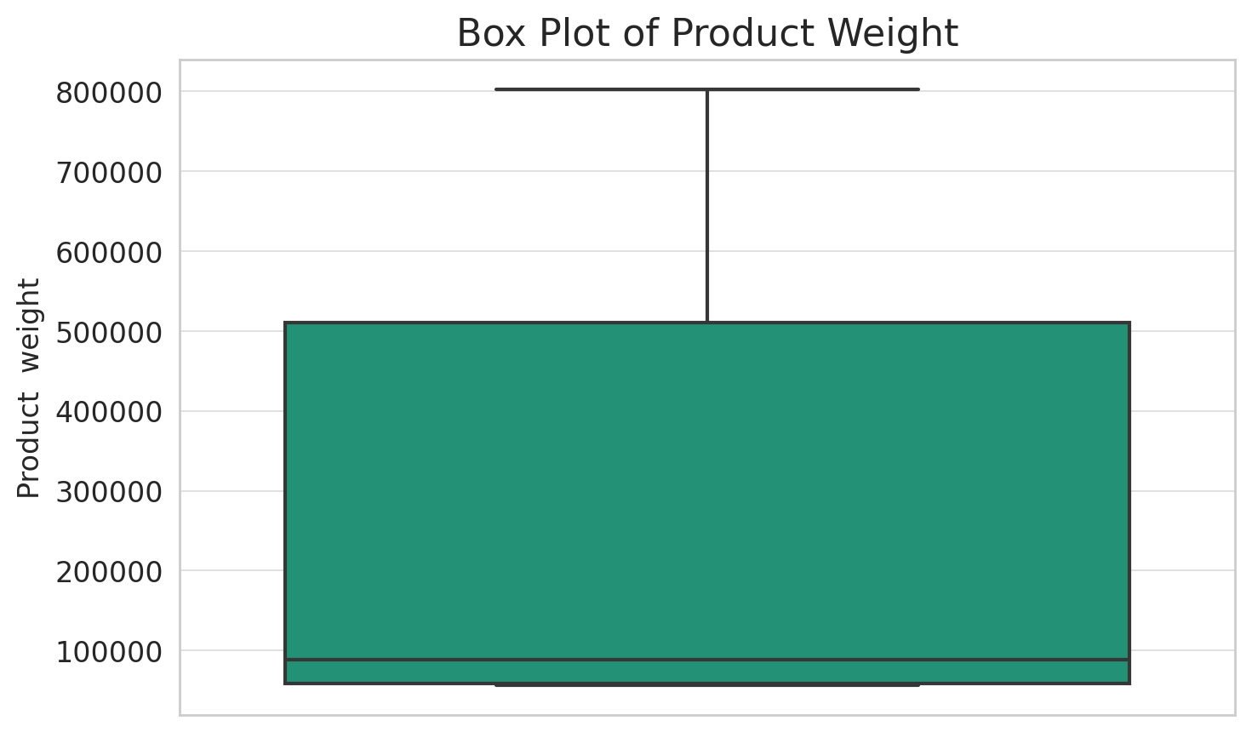
Distribution of weight data

Slide 13
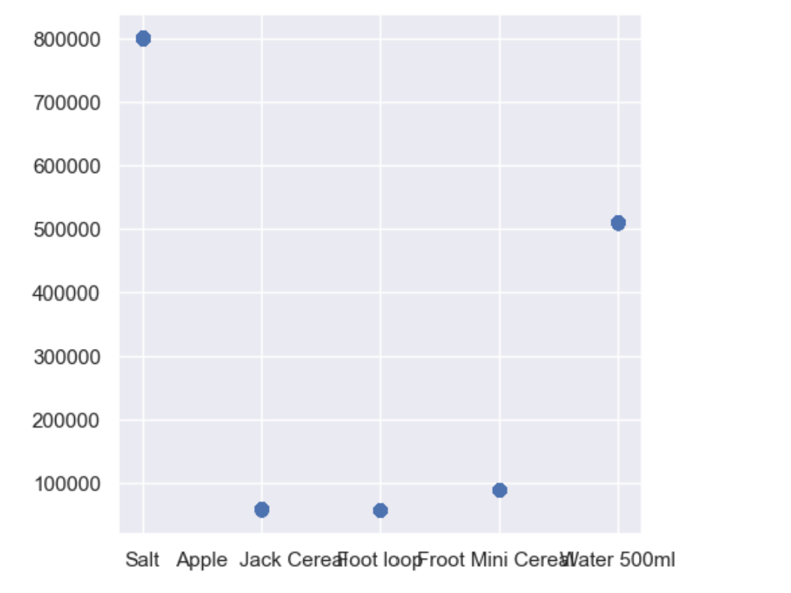
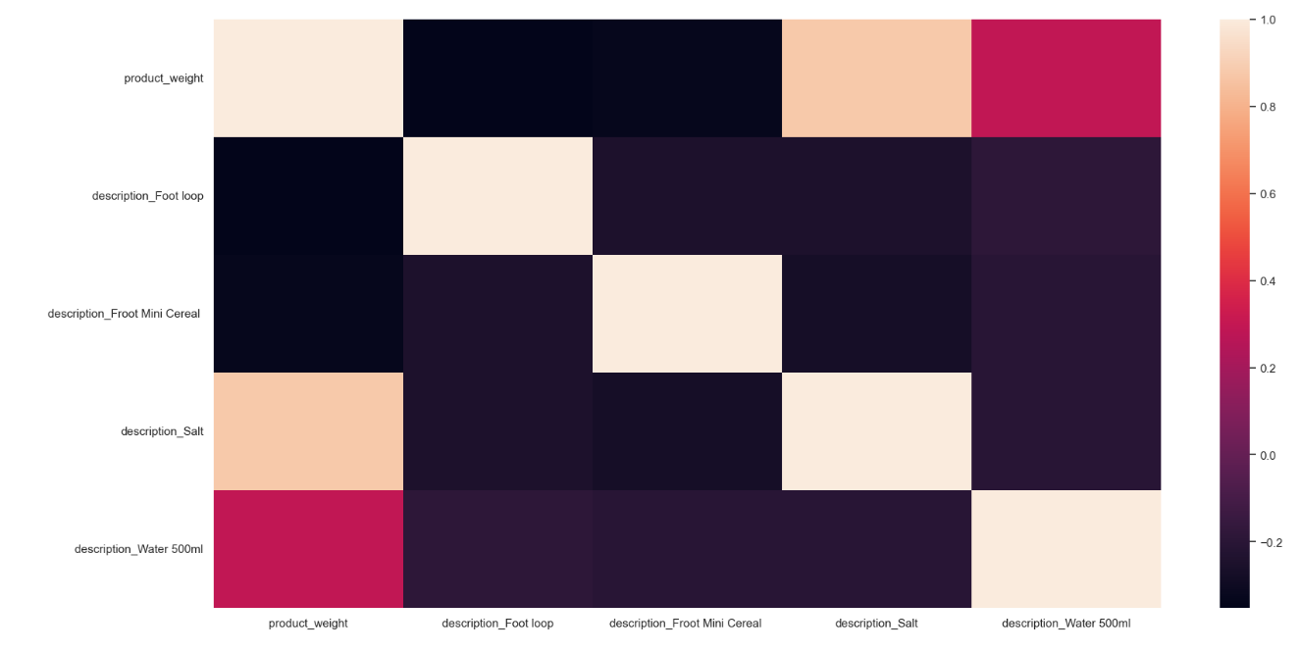
weight data and correlation among the data features

